Slide 1

Single-layer Perceptron: Multiclass Logistic Regression
Professor Jonathan Loo
Chair in Computing and Engineering
School of Engineering and Computing
University of West London

Slide 2
Lesson Outline
Multiclass Classification Problem
Single-layer Perceptions
Formulate multiclass logistic regression learning problem mathematically
One-hot encoding
Softmax
Neural network elements: Model, Loss Function, Cost function, Optimisation, Stochastic Gradient descent (SGD)
Neural network computation graph and analysis: Feedforward and Backpropagation
Homework Briefing
Notes:
http://rinterested.github.io/statistics/softmax.html

Slide 3
Multiclass Classification Problem

Slide 4
Multiclass Classification Problem
In our last lesson, we explored logistic regression (binary classification), where there were only two possible categories or classes. This is also known as two-class linear discrimination.
When we have three or more categories, we call the problem a multiclass classification problem.
Generalising a two-class to multiclass linear discriminant function requires some additional decision rules. The two most commonly used rules are:
one-vs-one
one-vs-all

Slide 5
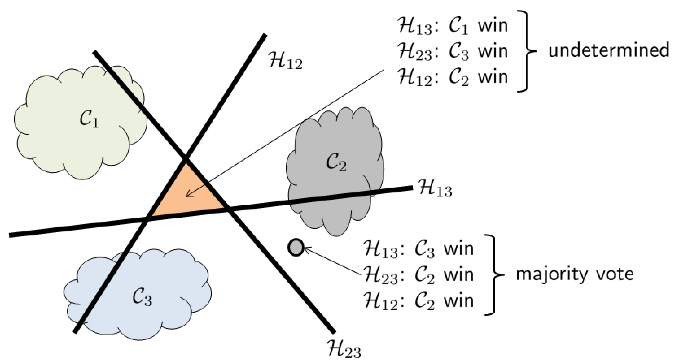
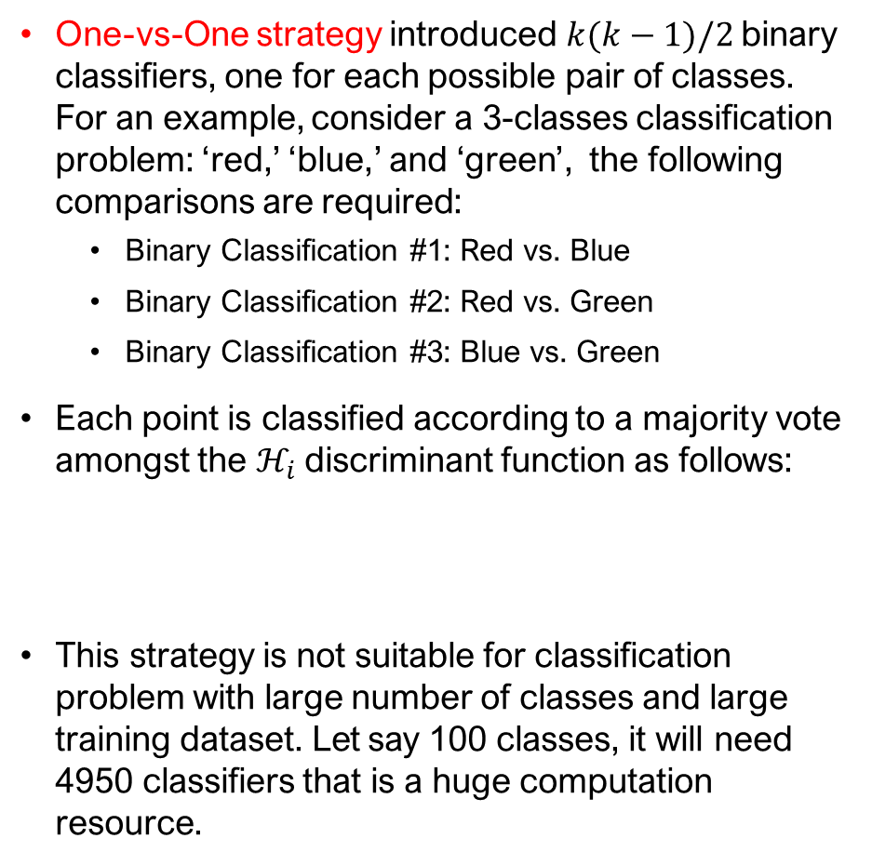
One-vs-One
One-vs-One strategy introduced $k(k−1)/2$ binary classifiers, one for each possible pair of classes. For an example, consider a 3-classes classification problem: ‘red,’ ‘blue,’ and ‘green’, the following comparisons are required:
Binary Classification #1: Red vs. Blue
Binary Classification #2: Red vs. Green
Binary Classification #3: Blue vs. Green
Each point is classified according to a majority vote amongst the $ℋ_{i}$discriminant function as follows:
This strategy is not suitable for classification problem with large number of classes and large training dataset. Let say 100 classes, it will need 4950 classifiers that is a huge computation resource.
This strategy is suggested for the implementation of Support Vector Machines (SVM) and related kernel-based algorithms, which normally used small classes and dataset.

Slide 6
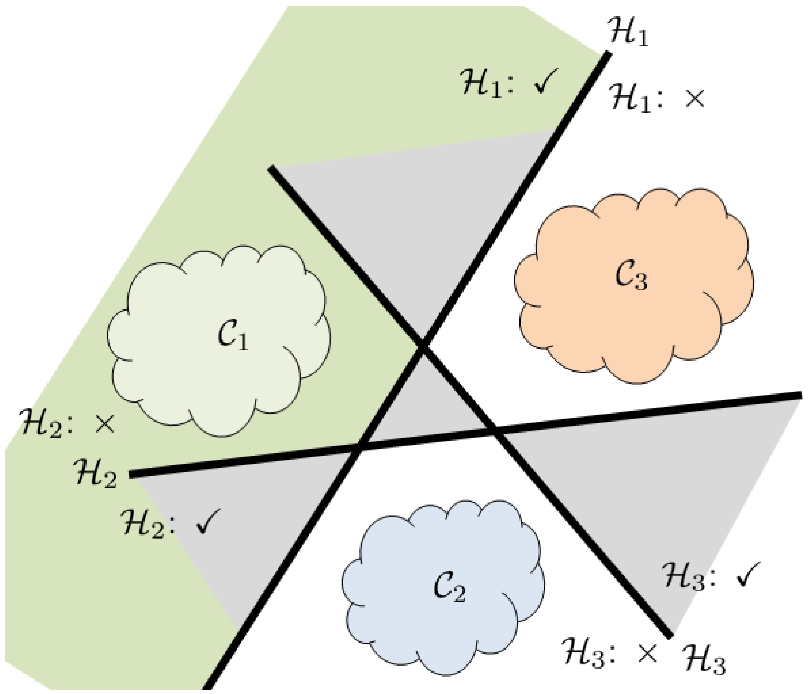
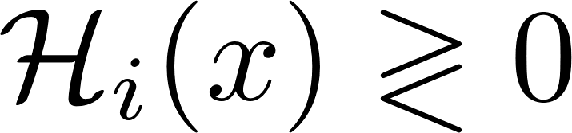
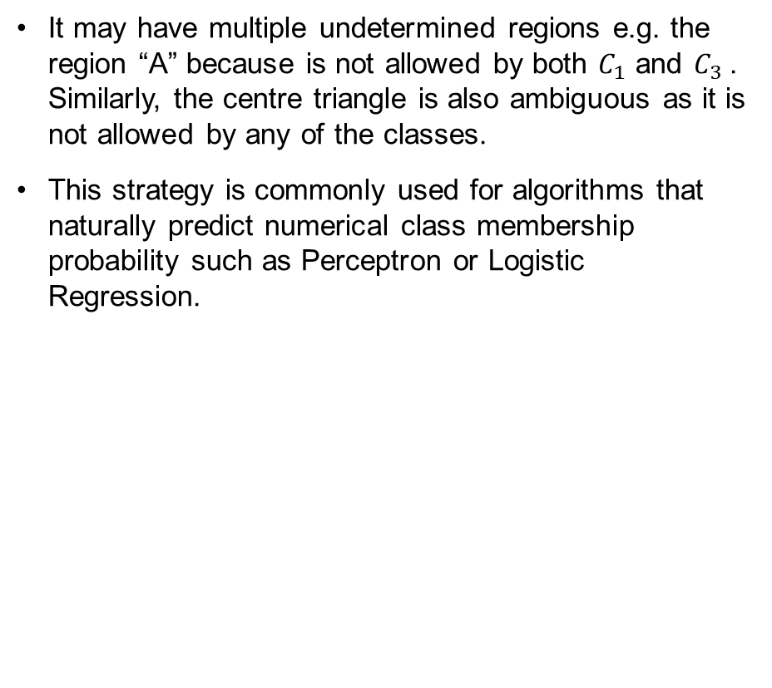
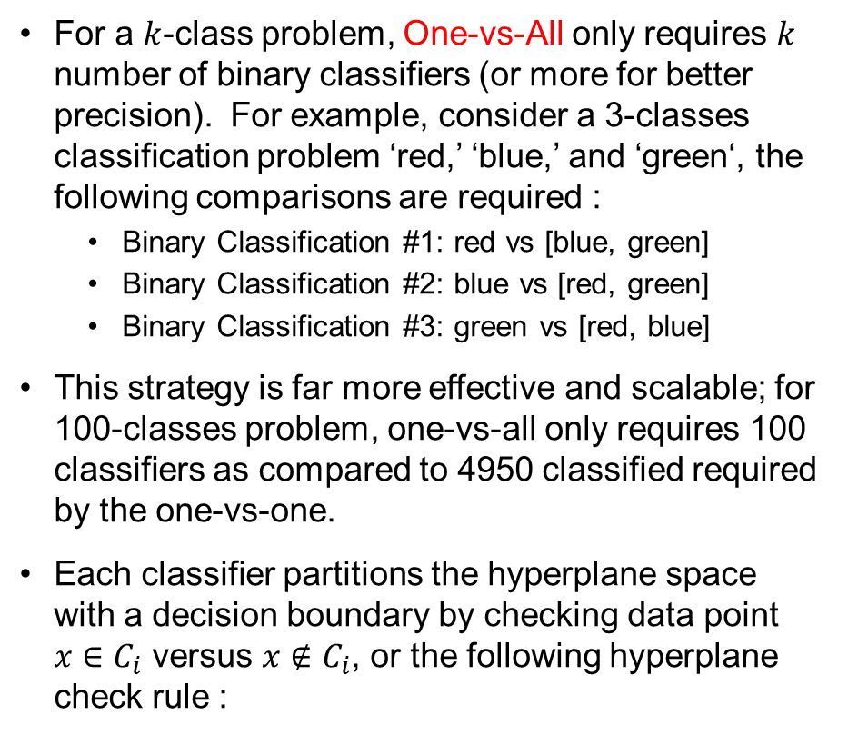
One-vs-All
For a $k$-class problem, One-vs-All only requires $k$ number of binary classifiers (or more for better precision). For example, consider a 3-classes classification problem ‘red,’ ‘blue,’ and ‘green‘, the following comparisons are required :
Binary Classification #1: red vs [blue, green]
Binary Classification #2: blue vs [red, green]
Binary Classification #3: green vs [red, blue]
This strategy is far more effective and scalable; for 100-classes problem, one-vs-all only requires 100 classifiers as compared to 4950 classified required by the one-vs-one.
Each classifier partitions the hyperplane space with a decision boundary by checking data point $x∈C_{i}$ versus $x∉C_{i}$, or the following hyperplane check rule :
It may have multiple undetermined regions e.g. the region “A” because is not allowed by both $C_{1}$ and $C_{3}$. Similarly, the centre triangle is also ambiguous as it is not allowed by any of the classes.
This strategy is commonly used for algorithms that naturally predict numerical class membership probability such as Perceptron or Logistic Regression.
A

Slide 7
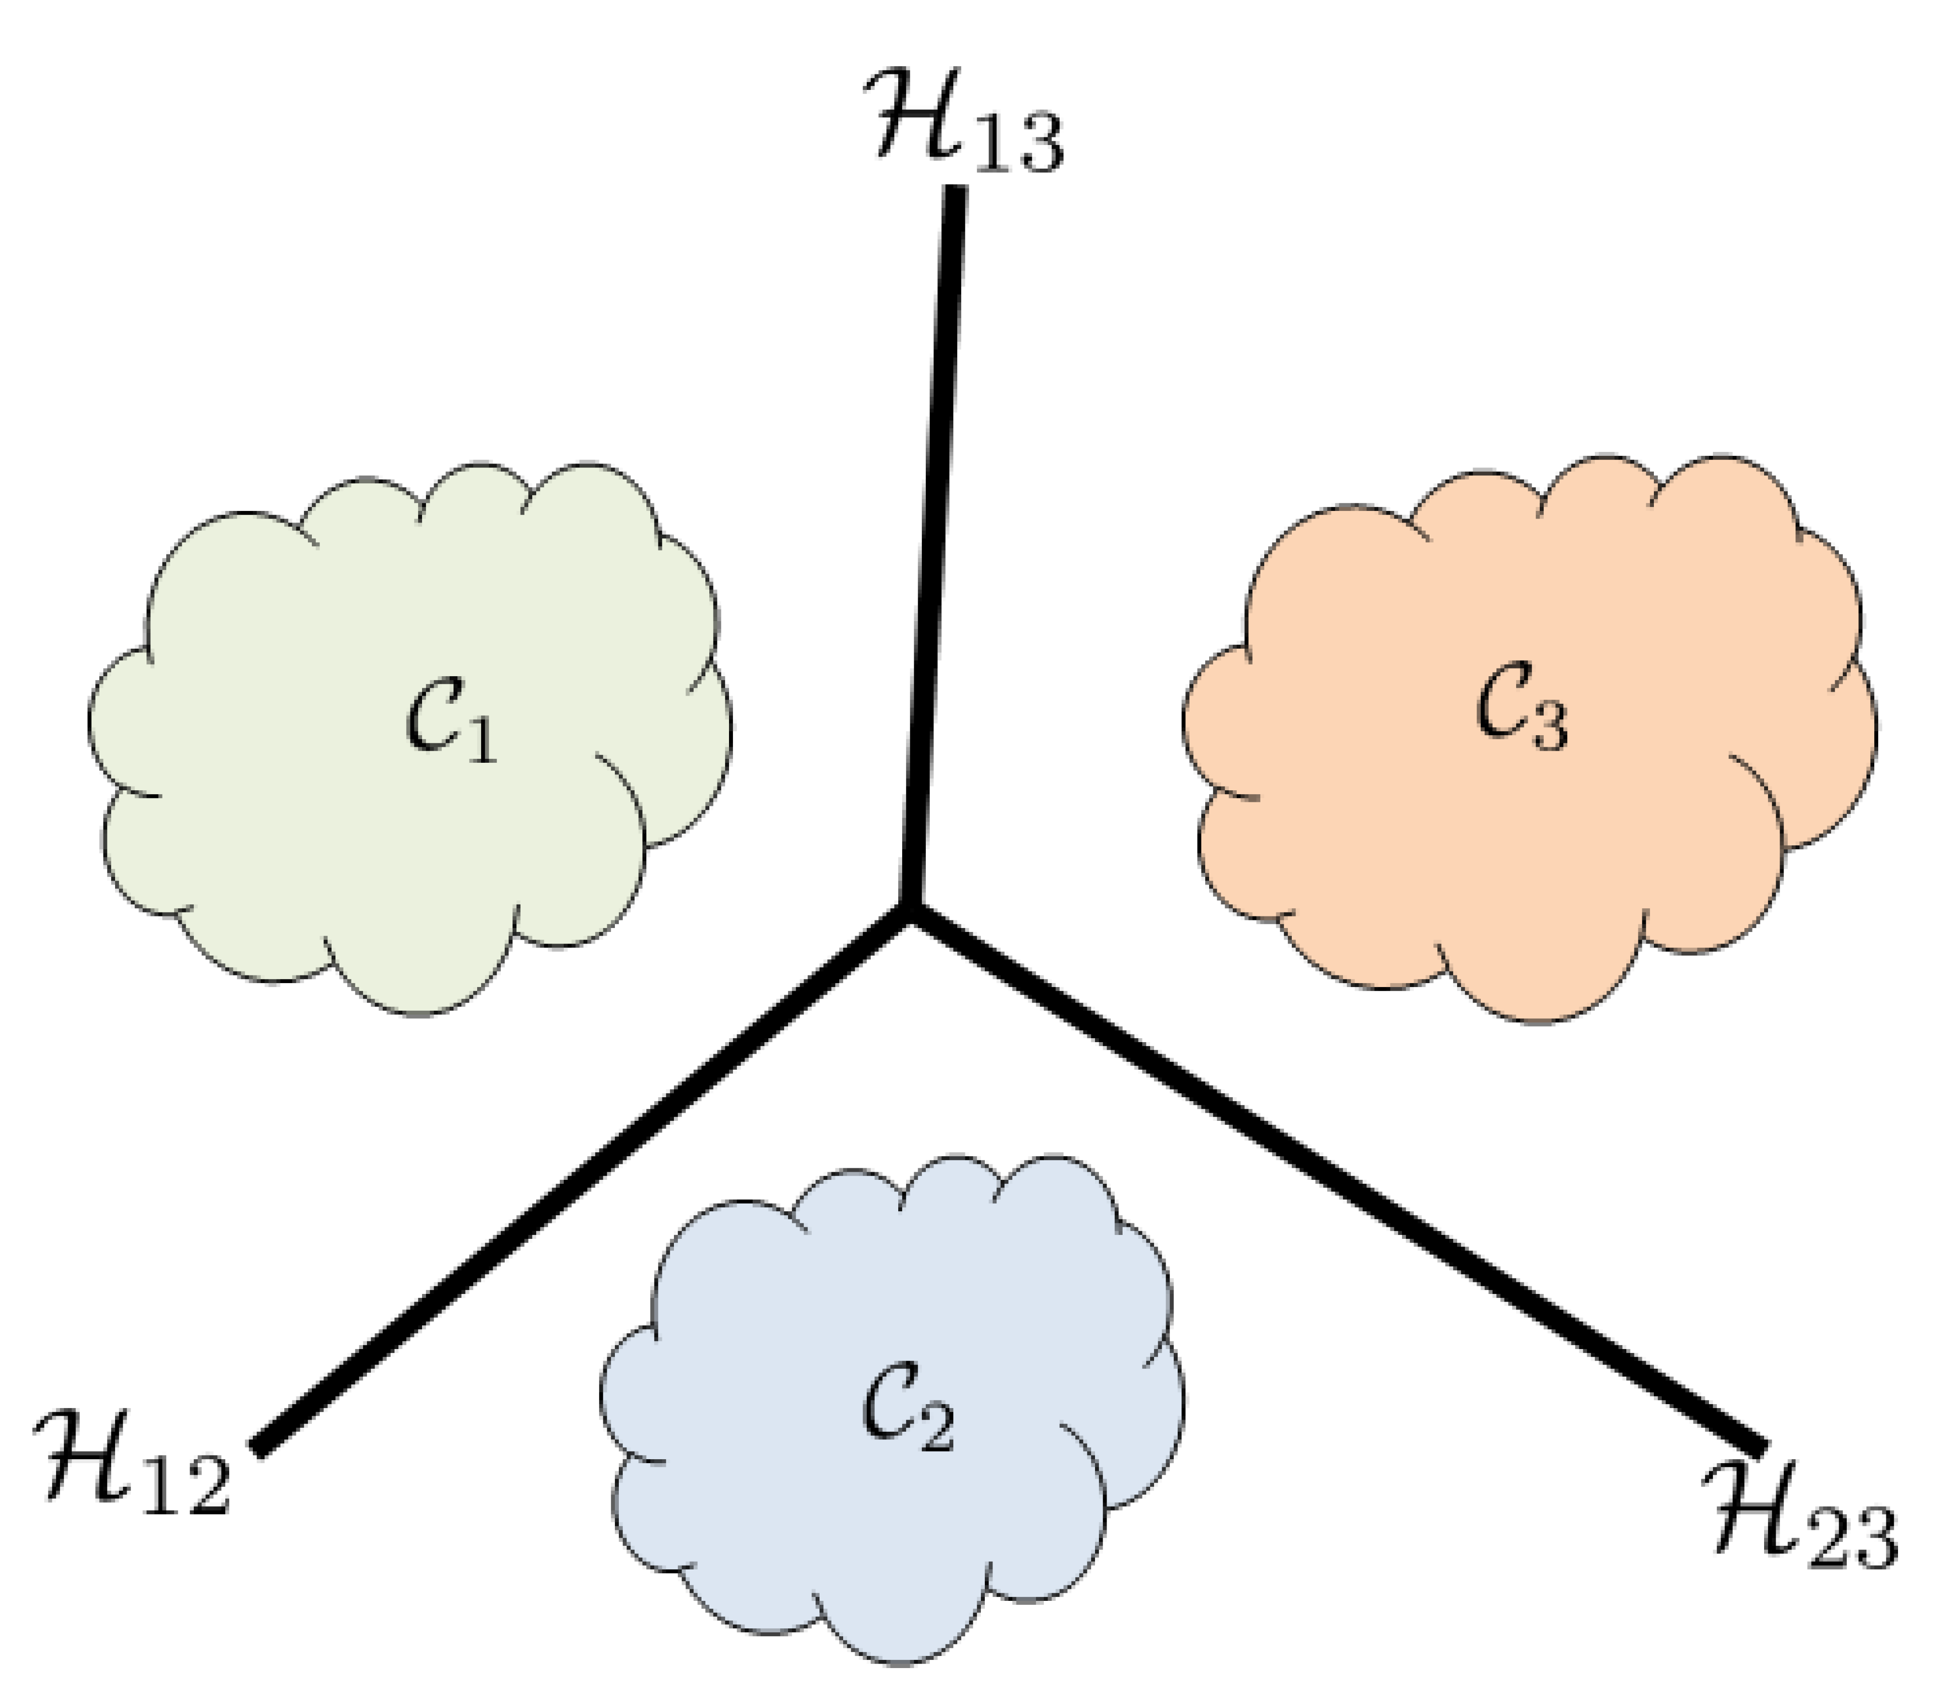
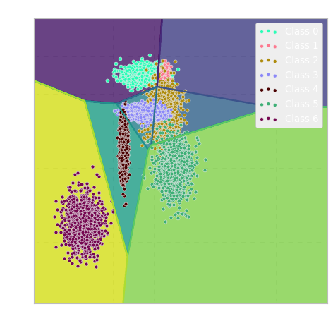
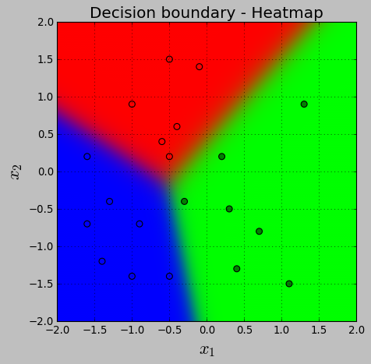
Linear Machine
Learning machine such as perceptron or logistic regression and is the common linear machine used as binary classification model that predicts a class membership probability i.e. maximum likelihood estimation is used to predict a class.
In linear machine, the decision boundaries partition the space into k classes, and no undetermined regions because the machine avoids the ambiguity because the maximum is point-wise.
Multiclass classification results produced by using a single-layer perceptions implementation of logistic regression

Slide 8
Neural Network Classification (Single-layer Perceptron)
Multiclass Logistic Regression

Slide 9
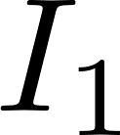
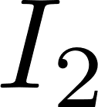


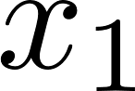

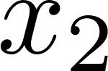


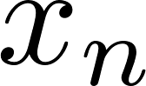
Recall: Perceptron
Input layer
Output Unit
Input layer
Output Unit
Linear node
Sigmoid node

Slide 10
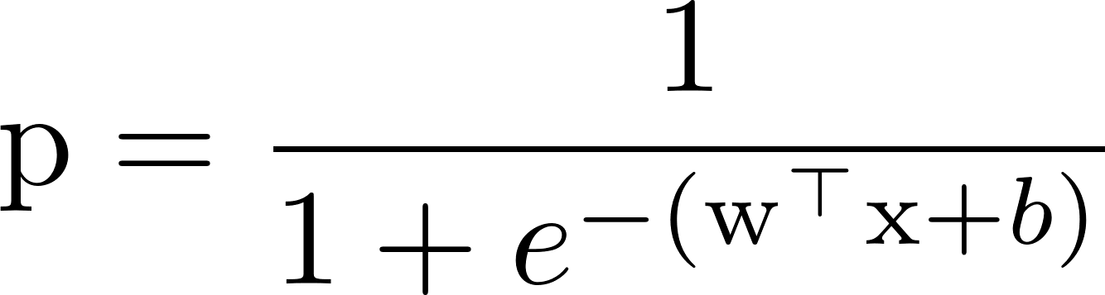
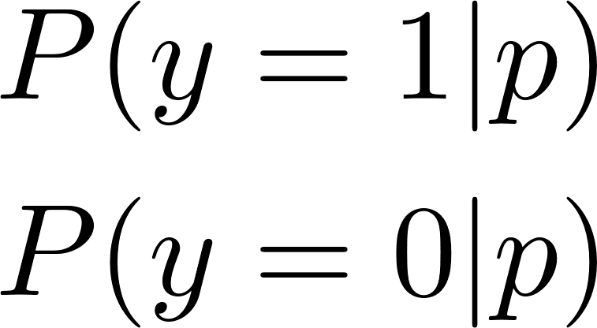
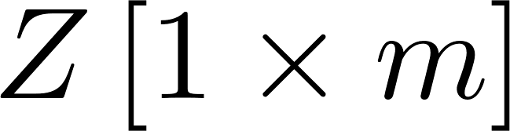
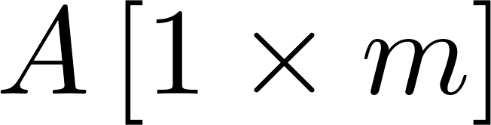
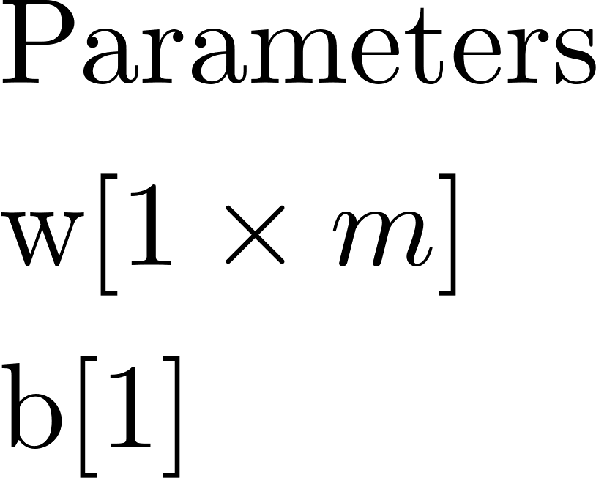
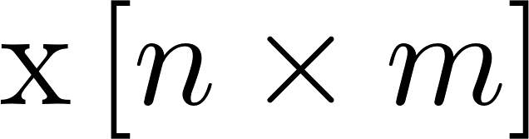
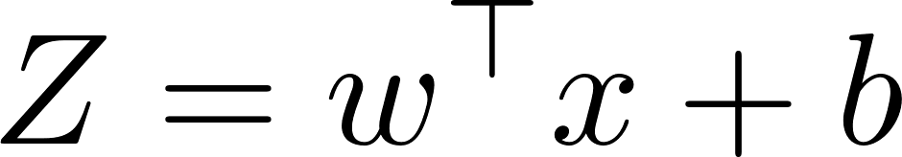
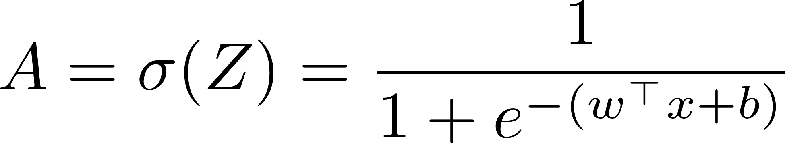
Recall: Logistic Regression Perceptron Model
Input layer
Output Unit
Linear node
Sigmoid node
Prediction
Binary
Classification

Slide 11



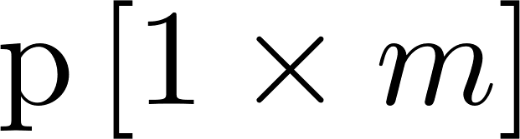
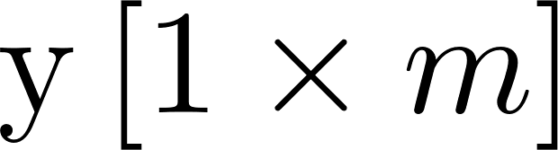
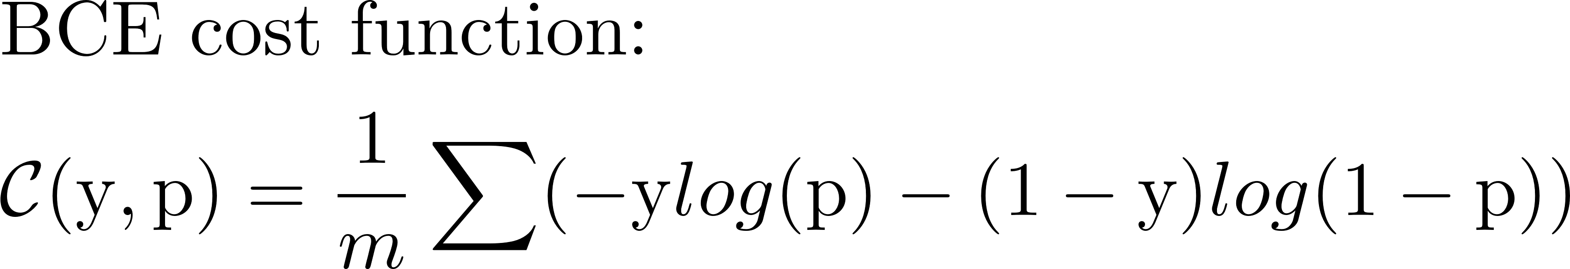
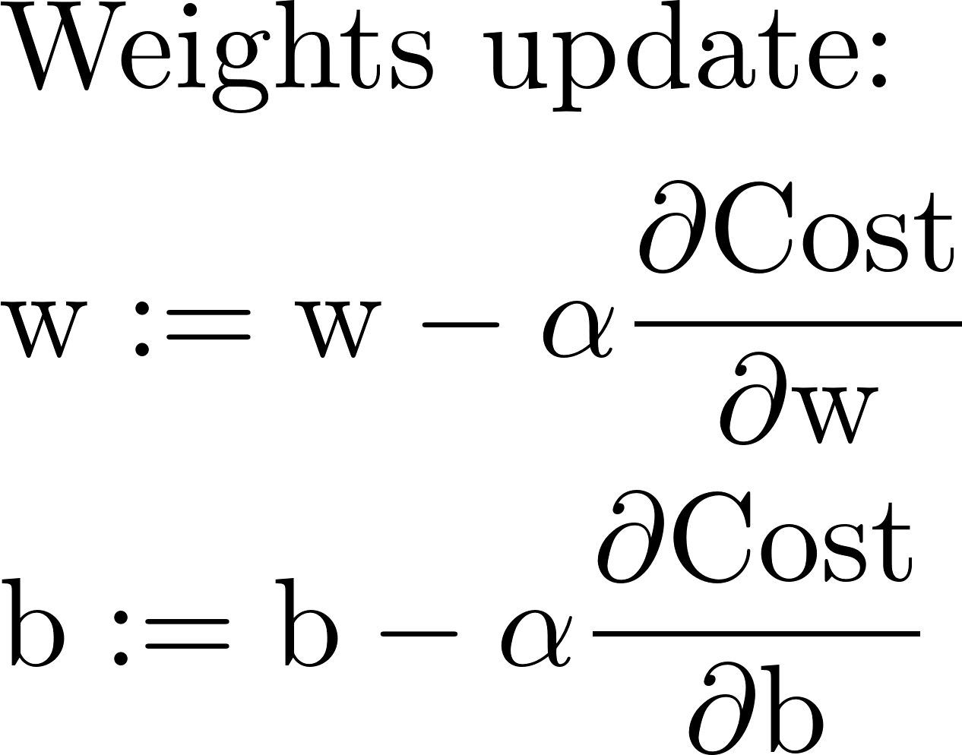
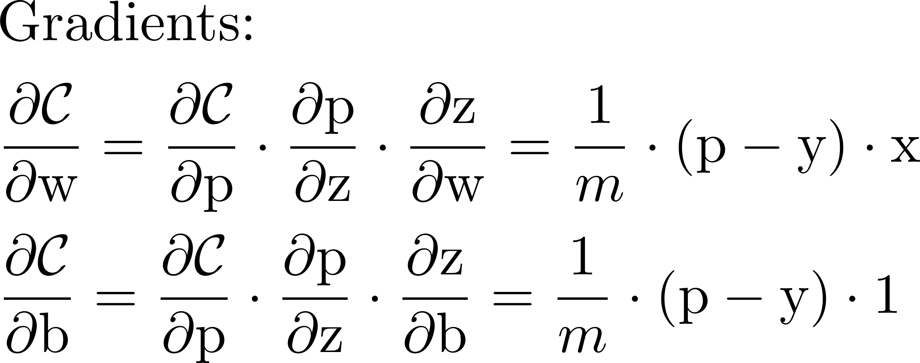
Recall: Logistic Regression Perceptron Model
Input layer
Output Unit
Linear node
Sigmoid node
Network training
Prediction
Target
Backpropagation

Slide 12




Single-layer Perceptron
Output layer
Input layer

Slide 13
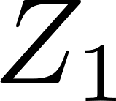


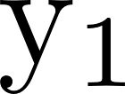
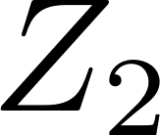
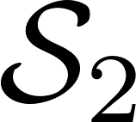
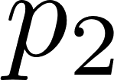
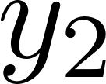
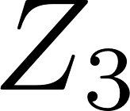
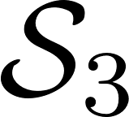
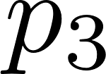
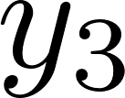
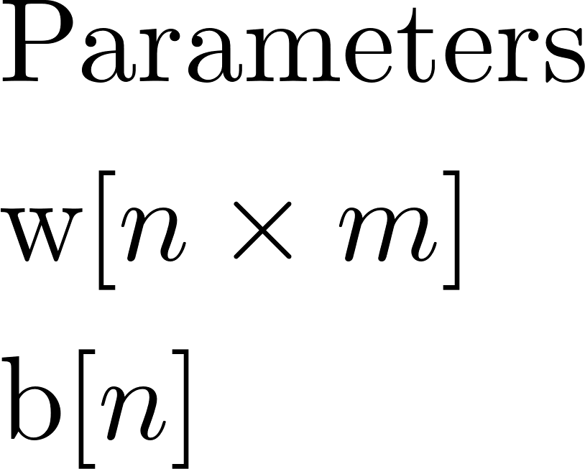
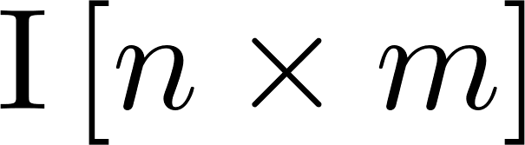
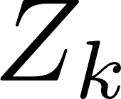

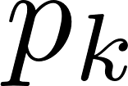

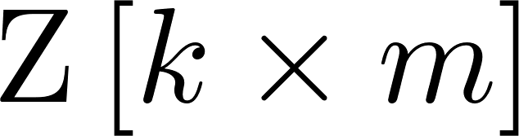
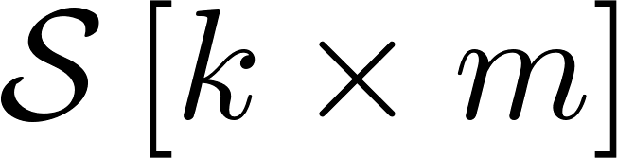
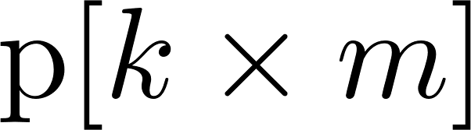
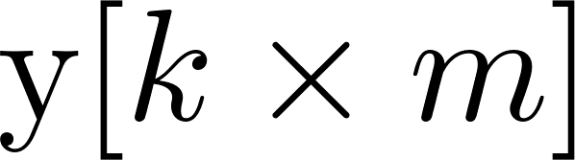
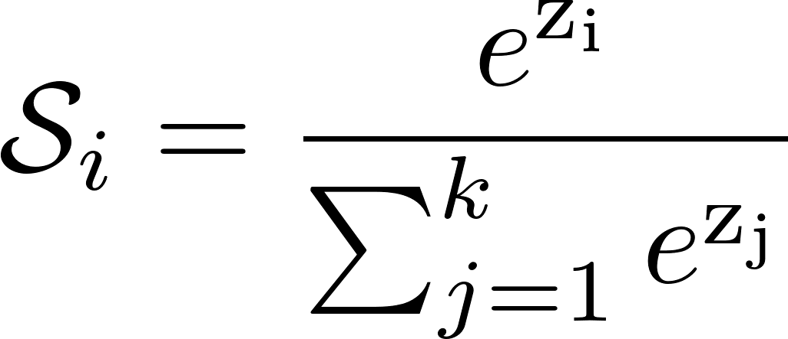
Multiclass Logistic Regression Perceptron Model
Output layer
Network training
Linear layer
Softmax layer
Prediction
Target
Input layer
Key elements:
Target labelling: one-hot encoding
Softmax: Normalised exponential function
Loss/Cost function: Cross-entropy
Backpropagation with Softmax and Cross-entropy
Cost calculation and
Backpropagation

Slide 14




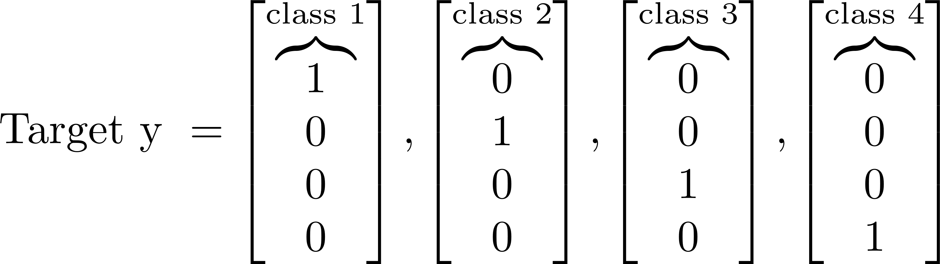
Multiclass Logistic Regression: Target Labelling
Machine learning models required all input and output variables to be numerical.
If your data contains categorical data, you must encode it to numbers before you can fit and evaluate a model.
Two most popular techniques:
Integer Encoding: The integer values have a natural ordered relationship between each other and machine learning algorithms may be able to understand and harness this relationship. For example, Dog=1, Cat=2, Lion=3, Leopard=4; you could build a machine learning to classify its category, as well as harness the relationship between the category e.g. how close Cat compared to Lion and Leopard using ordinal relationship in the integer values.
One-Hot Encoding: For categorical variables where no such ordinal relationship exists or required, the integer encoding would not be appropriate especially in our multiple logistic regression machine that predict a “1” for a target class and the rest {0} based on one-vs-all strategy. In this case, a one-hot encoding can be applied to the integer representation. This is where the integer encoded variable is removed and a new binary variable is added for each unique integer value.

Slide 15
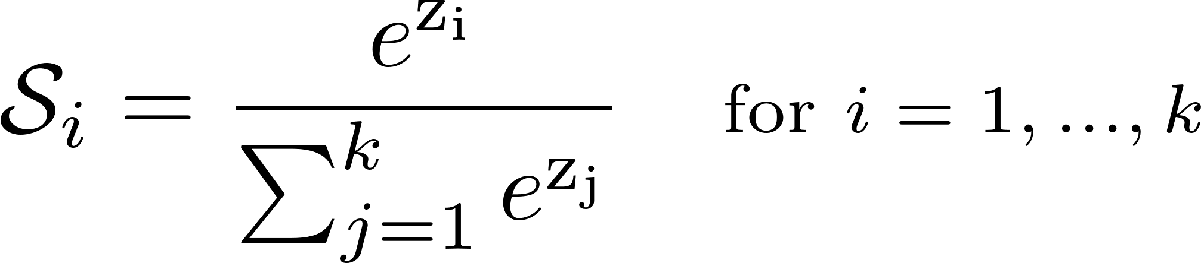
Multiclass Logistic Regression: Softmax
The Softmax is a form of logistic function (Sigmoid) that normalises a vector of input values follows a probability distribution whose total sums up to 1.
It is often used as the last activation function of a neural network to normalize the output of a network to a probability distribution over predicted output classes.
The output vector values are ranging between 0 and 1, which is the probabilities representation of each class in a multiclass classification neural network.
Softmax is used in discriminative models such as Cross-Entropy, for Loss and Cost function. Hence, Softmax is sometimes referred to as a multinomial logistic regression.

Slide 16
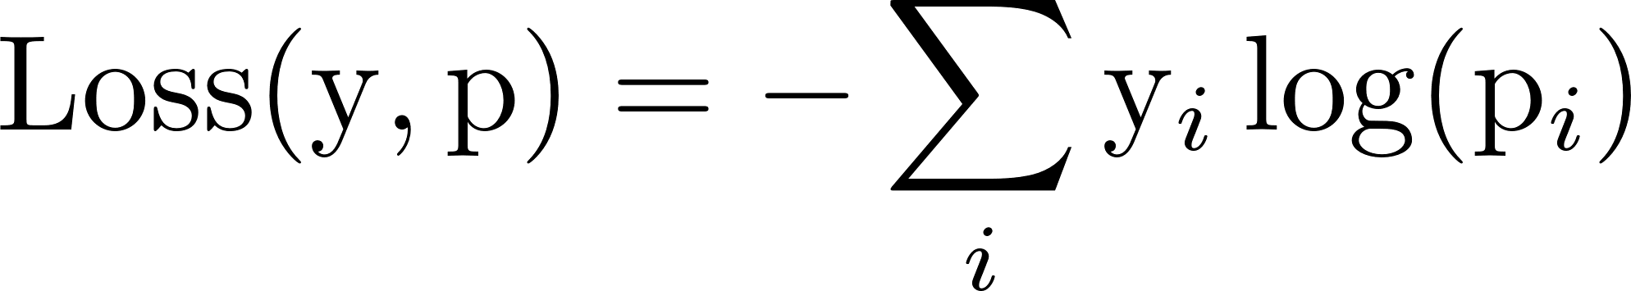
Multiclass Logistic Regression: Loss Function
Recalled the cross-entropy loss function, introduced in the previous lesson, that is used to measure the dissimilarity between two probability distributions y and p, commonly used in multiclass classification problem:

Slide 17
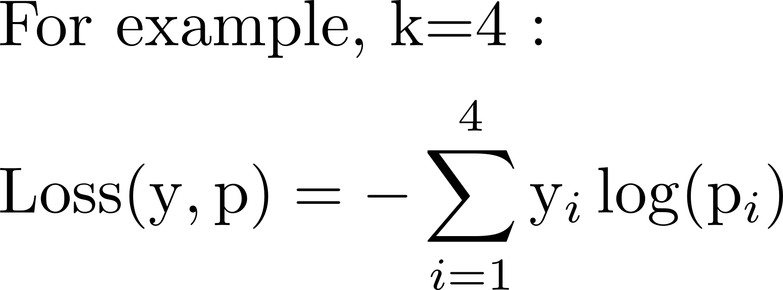
Multiclass Logistic Regression: Loss Function
Recalled the cross-entropy loss function, introduced in the previous lesson, that is used to measure the dissimilarity between two probability distributions y and p, commonly used in multiclass classification problem:
Prediction
Target
Loss
Note: we interchange the use of words like “Loss” and “Error” to allow different perspective of discussion
Note that the “log()” written here is the “natural log”, which is equivalent to “ln()” in some implementation e.g. Microsoft Excel.

Slide 18

Multiclass Logistic Regression: Cost Function
Finally, we’ll divide the negative log-likelihood function by the total number of examples(m) and minimise that function, and we obtain Cost function as follows:

Slide 19
Multiclass Logistic Regression: Backpropagation
Recall that for the network training process, backpropagation is to calculate the gradient of the cost w.r.t the weight, and the gradient is used to update the weights as to minimise the loss between the predicted and target values.
Given that we use a softmax output layer and the cross-entropy cost for multiclass classification problem, we can derive our backpropagation computation as follows:
Gradient of cost w.r.t input Softmax
Gradient of cost w.r.t to weights and weights update

Slide 20

Multiclass Logistic Regression: Gradient of Loss w.r.t Input of Softmax (Method 1)
Our aim is to compute the gradient of the Cost w.r.t input of Softmax.
Here, we will first derive the gradient of the Loss w.r.t. input of Softmax:
Gradient of Cost w.r.t. Input of Softmax
Local derivative of Softmax
Local derivative of Loss
Prediction
Target
Loss

Slide 21



Multiclass Logistic Regression: Gradient of Loss w.r.t Input of Softmax (Method 1)
Here, we continue deriving the previous equation:
Note 5: This is the local derivative of Softmax function, which has 2 conditions.
Note 6: This is expanding the derivative term with the 2 conditions
Note 7: This term is mainly focusing on the target vector

Slide 22



Multiclass Logistic Regression: Gradient of Loss w.r.t Input of Softmax (Method 2)
Step 1: Local derivative of Loss:
Here, we demonstrate a step-by-step approach to derive the gradient of the Loss w.r.t. input of Softmax.
Gradient of Cost w.r.t. Input of Softmax
Local derivative of Softmax
Local derivative of Loss
Prediction
Target
Loss
Step 2: Local derivation of Softmax:
Gradient of Loss w.r.t. Input of Softmax:

Slide 23

Multiclass Logistic Regression: Gradient of Cost w.r.t Input of Softmax
Finally, we divide the gradient of Loss w.r.t. input of Softmax by the total number of samples (m), and we obtain the gradient of Cost w.r.t input of Softmax
Gradient of Cost w.r.t. Input of Softmax
Local derivative of Softmax
Local derivative of Loss
Prediction
Target
Loss

Slide 24


Multiclass Logistic Regression: Gradient of Cost w.r.t Weights & Update
Gradient of Cost w.r.t. Weights
Weight Update

Slide 25
Neural Network Computation Graph and Analysis
Binary to decimal function approximation using multiclass logistic regression

Slide 26








Problem Setup: Binary to decimal decoder
Prediction
Binary to decimal decoder function approximation using multiclass logistic regression
1
1
0
1
0
1

Slide 27





Forward computation: Linear layer
Prediction

Slide 28


Forward computation: Softmax layer
Prediction

Slide 29




Forward computation: Cost Function
Prediction

Slide 30



Forward computation: Gradients
Prediction

Slide 31



Forward computation: Gradients
Prediction

Slide 32


Forward computation: Gradients
Prediction

Slide 33




Forward computation: Gradients
Prediction

Slide 34
End of Lesson

